Slide 1








Slide 2
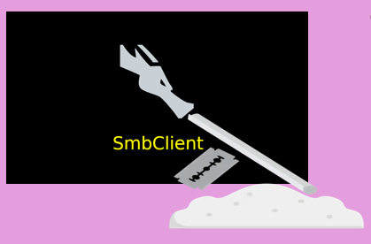




To recap…
Active directory
Directory structure used by Windows devices
Tools
SMB Client
Crackmapexec
MSSQL
WinPEAS
Evil-WinRM

Slide 3




A Public CA is a trusted third party that grants SSL certificates to organisations for the use of sending encrypted data across the internet – HTTPS
Validate PKI keys to generate the Digital Certificate
Poorly managed PKI Keys can be used to impersonate a legit website
Revoked
Outdated
It is good practice for an organisation to check their SSL cert with their CA’s OSCP regularly

Slide 4


Kerberos is an old, but still widely used, service that grants time-sensitive authorisation tickets to users for passing network restrictions in the Org’s AD.
Accepts a password to verify user’s identity before granting them an access ticket
An attacker with a foothold can use Mimikatz to dump a ticket from the Kerberos Ticket Granting Service of a vulnerable account to acquire an NTLM hash which can be cracked offline with Hashcat or John (Kerberoasting)

Slide 5


Automates the collection of AD information
Comprised of SharpHound, Neo4j and Bloodhound GUI
Used for Vulnerability scanning in AD environment
Visually maps account and group permissions, scanning for misconfigurations in the Certificate Authority and can identify users with high permissions that could be vulnerable to Kerberoasting

Slide 6

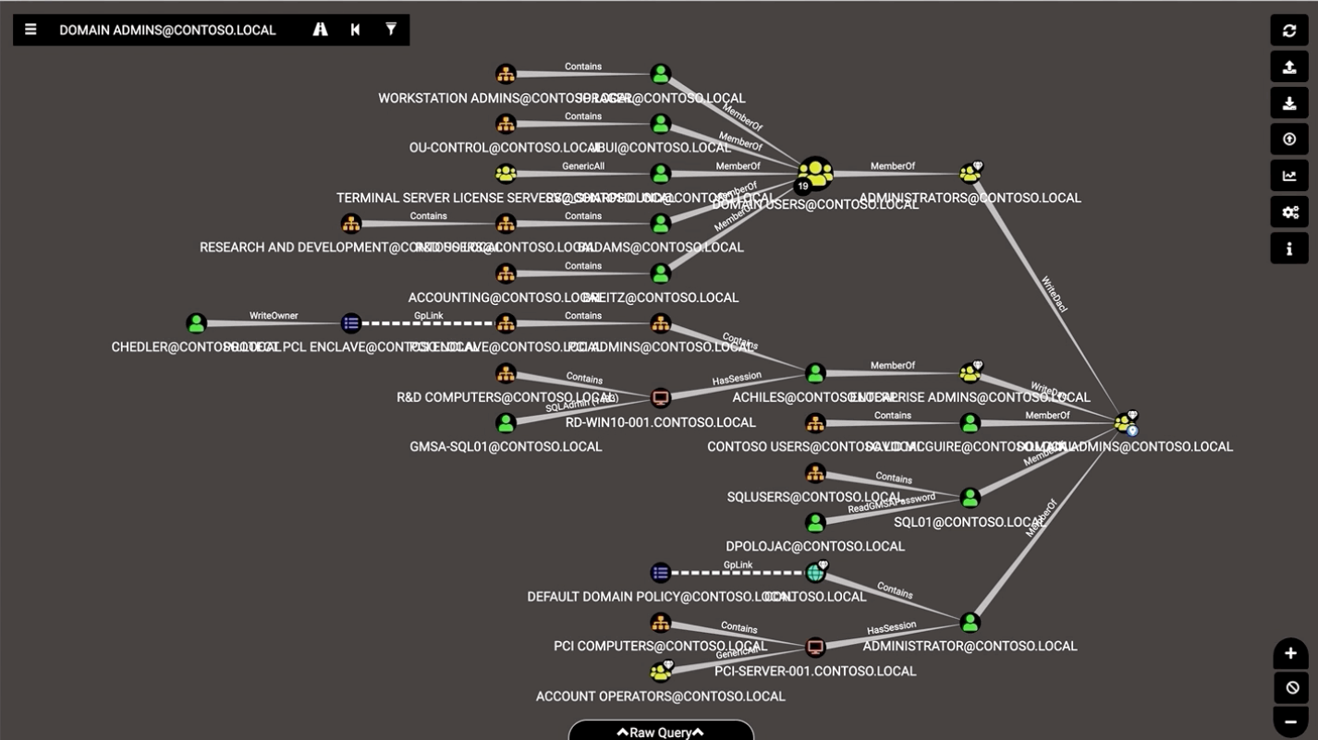

Analysis is copmlete
Domain Information
Dangerous Privileges
Bloodhound identifies users or groups that have been granted vulnerable privileges
Kerberos Interaction
Finds Kerberoastable users
A handy graphical map of the relations between users and servers

Slide 7


Used by hackers to create a false SSL certificate by copying a compromised template
This command is used to enumerate potentially vulnerable templates certificate templates.
If the template can be used, the malicious certificate can be generated with the following command
The Malicious Certificate can then be used to bypass Kerberos authentication.

Slide 8


Multi-tool-type hacking program that brings together multiple credential harvesting/forging attacks
E.g. NTLM Relay, Pass-The-Hash and Kerberoasting
NTLM Relay is where the NTLM authentication is relayed directly to the SMB and credential requirements are bypassed
Pass-the-hash is the workaround for the breaking of an NTLM hash where the hacker provides the account name and associated hash and the exploit does the rest
Packet

